Slide 1
Nuclear Fuel Performance
NE-591-010
Spring 2021

Slide 2
MOOSE– Massively Object-Oriented Simulation Environment
the multiphysics framework
https://mooseframework.inl.gov/

Slide 4
MOOSE Physics Modules
Chemical Reactions Contact External PETSc Solver Fluid Properties Function Expansion Tools Heat Conduction Level Set Navier Stokes
Phase Field Porous Flow rDG Stochastic Tools Tensor (solid) Mechanics XFEM Shallow Water (work in progress) Ray Tracing (work in progress)

Slide 5
Governing Equations

Slide 6
Input Files

Slide 7
Input File

Slide 9
Run Example via Command Line

Slide 10
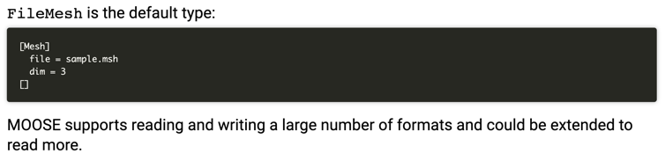
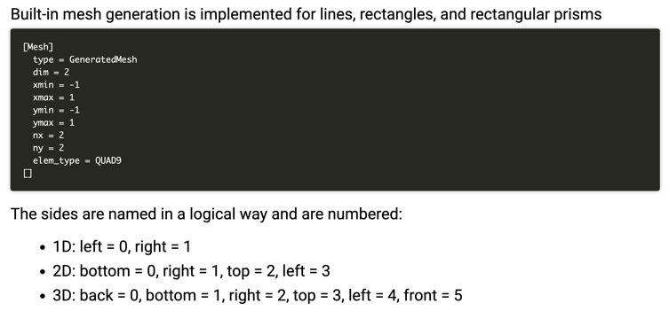
Mesh

Slide 11
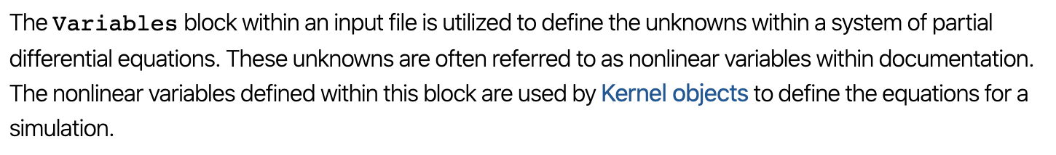
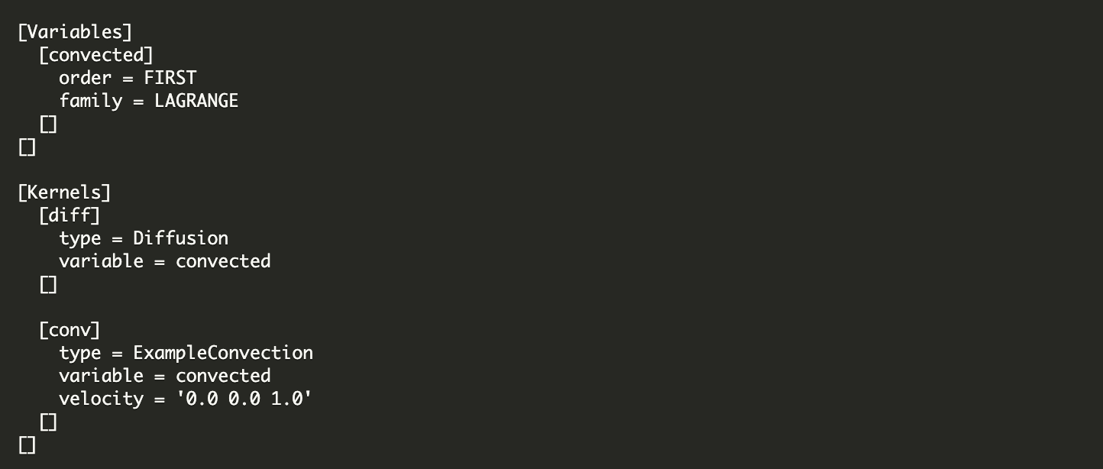
Variables

Slide 12
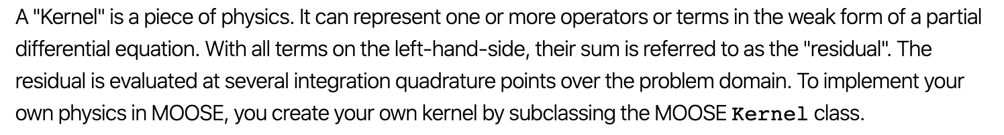
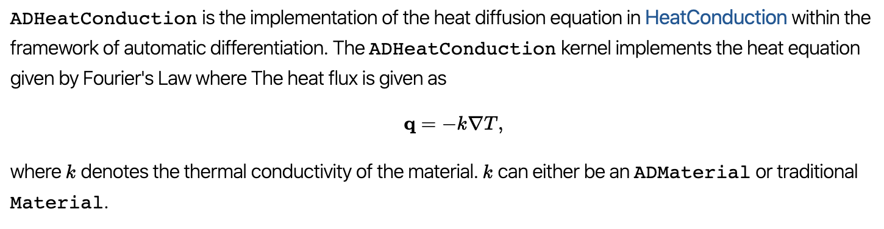
Kernel

Slide 13
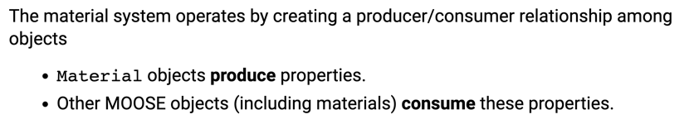
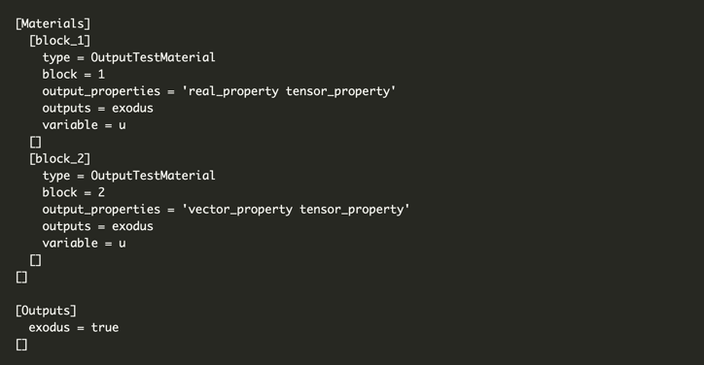
Materials

Slide 14
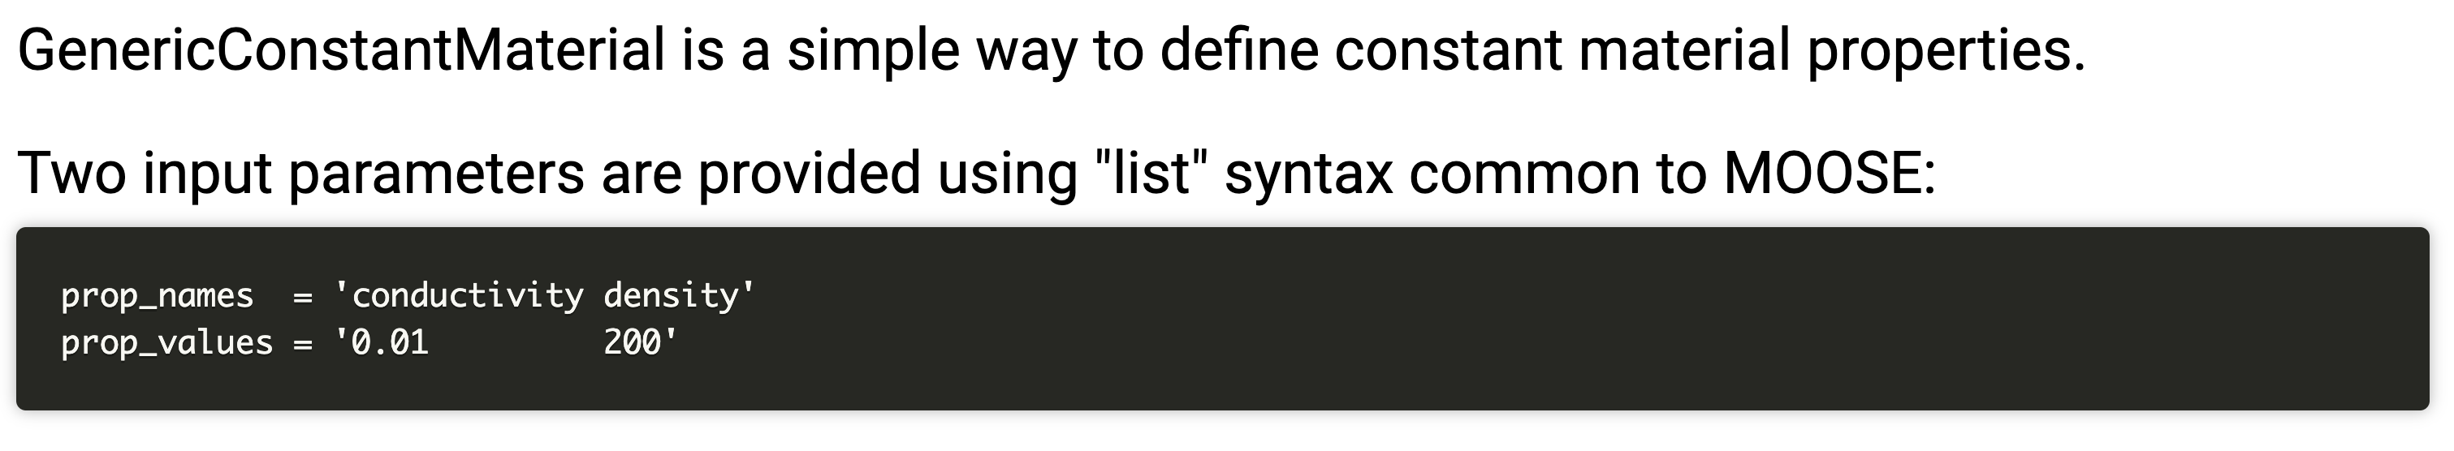
GenericConstantMaterials

Slide 15
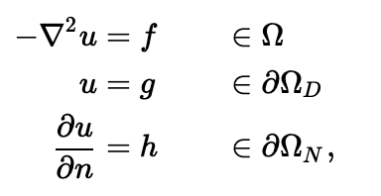
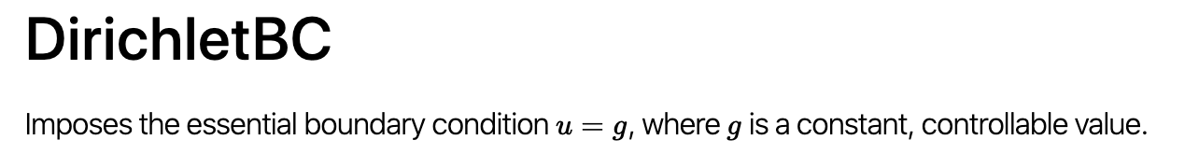
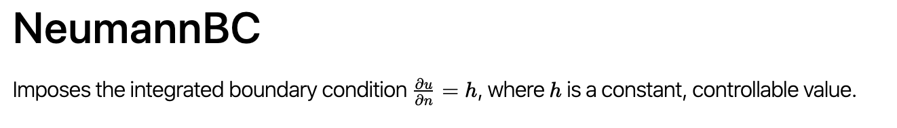
Boundary Conditions

Slide 16
MOOSE Solve Types

Slide 17
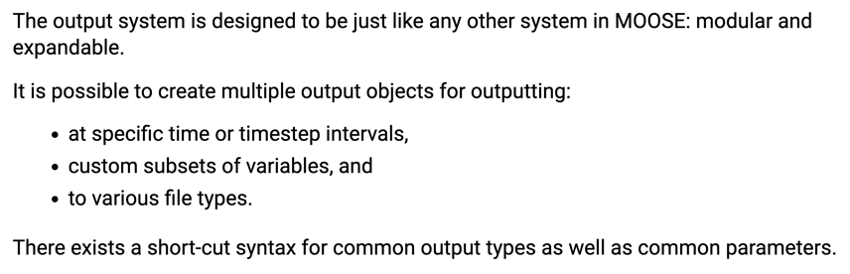
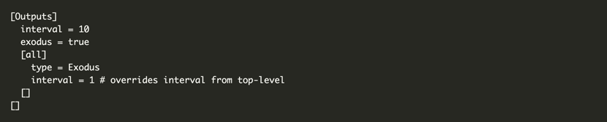
Outputs

Slide 18
Visualization
Two ways to visualize
Peacock: MOOSE GUI
Paraview: External software program that can read exodus files
I recommend downloading paraview
It is free and open source
Very flexible
Less buggy than peacock
But, if you try peacock, and it works for you, great!

Slide 19
Paraview
Open new
Move forward in time
Select Properties

Slide 20
MOOSE C++ Fundamentals
Will not cover here, if you feel like you need some background, go to below site, where they have some basics
https://mooseframework.org/workshop/#/10

Slide 21
Tutorials/Examples
A stepped example/tutorial lives in:
moose/tutorials/darcy_thermo_mech
This tutorial has 11 steps where they add complexity to a moose input file/physics problem
This is a VERY valuable exercise to work through
Tip : ./mooseapp-opt --dump > syntax.out creates a file “syntax.out” with all of the moose syntax and usage
Better tip: mooseframework.org is a great resource with everything documented

Slide 22
Access to MOOSE
Everyone has access to the RDFMG cluster
Can utilize moose on your local machine, or on cluster
If off campus, need to get the NCSU VPN
https://oit.ncsu.edu/campus-it/campus-data-network/vpn/
Need some kind of terminal
linux/mac is native, for windows need something like PuTTY, Cygwin, MobaXterm, etc.
ssh uname@rdfmg.ne.ncsu.edu

Slide 23
Building MOOSE on RDFMG cluster
mkdir projects
cd projects
git clone https://github.com/idaholab/moose.git
module load GCC/8.3.0-2.32
module load OpenMPI/4.0.1-GCC-8.3.0-2.32
module load cmake/3.6.3
module load PETSc/3.9.1-foss-2018a-downloaded-deps
module load Python/3.7.4-GCCcore-8.3.0
cd moose
./scripts/update_and_rebuild_libmesh.sh ## Note: this step takes a while
cd test
make -j 4
./run_tests -j 4

Slide 24
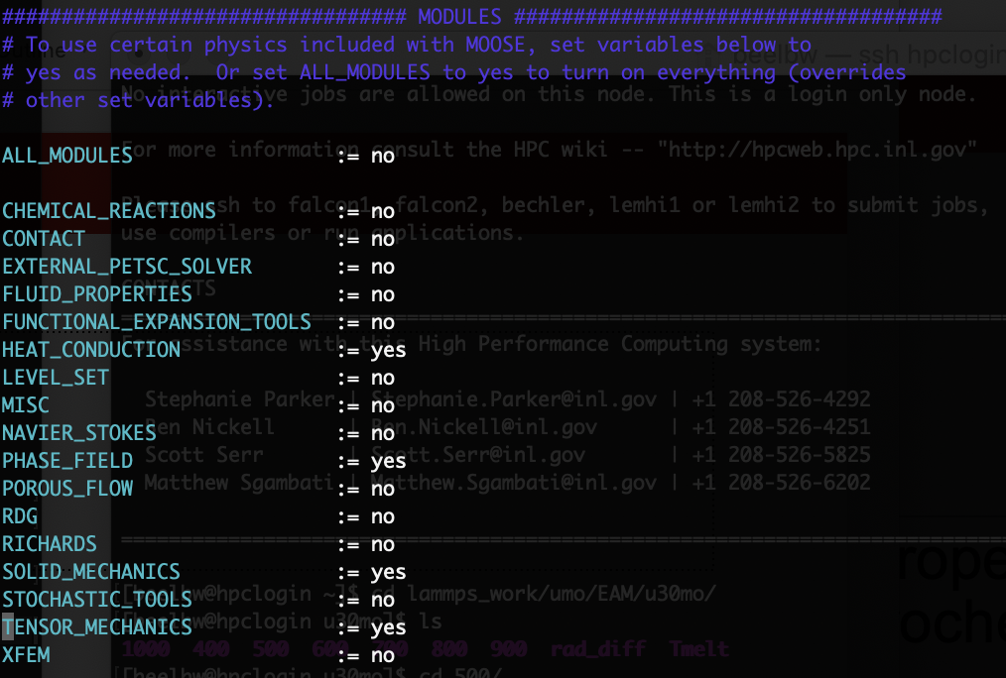
Making your own App and compiling
Edit makefile to match right->
vi Makefile

Slide 25
Handy bash commands
ssh username@rdfmg.ne.ncsu.edu : allows you to get on the cluster
sftp username@rdfmg.ne.ncsu.edu : allows you to transfer files to/from cluster
ls : list files in a directory; pwd: print working directory; cd : change directory; cp : copy a file
file editors: vi, vim, emacs, nano, atom
slurm is the submission manager
sbatch submit.sh: submit job with submit script
squeue : check status of jobs
I will provide you will a submit script that you will need to lightly edit

Slide 26
“1-D” MOOSE Project
0.5 cm
0.1 cm
0.1 cm
Fuel pin dimensions listed
Assume reasonable values for thermal conductivities
Can assume constant k
Outer cladding: 500 K
Mesh: 100x100
Solve temperature profile for:
Steady-state: Volumetric/Areal heating rate:
Q = 250 W/cm²
Solve for centerline temperature vs time
Transient: Volumetric/Areal heating rate
Q = 150*(1-EXP(-0.01*time))+250 for up to t=200
1 cm
Fuel
Cladding
Gap

Slide 27
2-D MOOSE Project
0.5 cm
0.1 cm
0.1 cm
Fuel pin dimensions listed
Assume reasonable values for thermal conductivities
Can assume constant k
Utilize azial T_{CO}, with reasonable flow rate, heat capacity, etc.
Solve temperature profile for:
Steady-state: Volumetric/Areal heating rate: Q = 250 W/cm²
@ z=0.25, z=0.5, z=1
Solve for centerline temperature vs time
Transient: Volumetric/Areal heating rate
Q = 150*(1-EXP(-0.01*time))+250 for up to t=200
@ z=0.25, z=0.5, z=1
Find location of peak centerline temperature at SS, and at t=200 in transient
1 m
Fuel
Gap
Cladding

Slide 28
Submission
Will upload four input and four output files
“1D” SS, “1-D” transient, 2-D SS, 2-D transient
Will upload a written report, 5-10 pages (including figures), times new roman, 12pt, 1.5 space
Due April 30 (last day of classes)
This is an individual project, but some collaboration is encouraged

